Slide 1
Giveth Visual Identity
‘the evolution’
version 0.1
Sep 2017
Grace Torrellas

Slide 2
Transitioning our Brand Identity
Giveth
Dapp (the platform)
Giveth
Unicorn DAC

Slide 3
The Dapp vs the DAC
Dapp
Visuals need to instill high levels of credibility, trust, loyalty and global scalability
DAC (Unicorn Community)
The DAC develops and supports the Giveth platform. The core team needs to be aligned in values and purpose while maintaining a strong sense of collaboration. The DAC is informal, fair and fun. It has developed its own identity.

Slide 4
Giveth brand invites the community to connect, get involved, create and transform
friendly, honest and trustworthy, it speaks from the heart.
Our brand wants to be related to projects that can scale and offer limitless possibilities to help a good cause.

Slide 5
our focus is to attract purpose, facilitate funding and enable support for the cause.
Giveth

Slide 6
Giveth Brand
Logo, colors, visual identity (relations), voice, values/Ideals and user experience

Slide 7
Logo

Slide 8
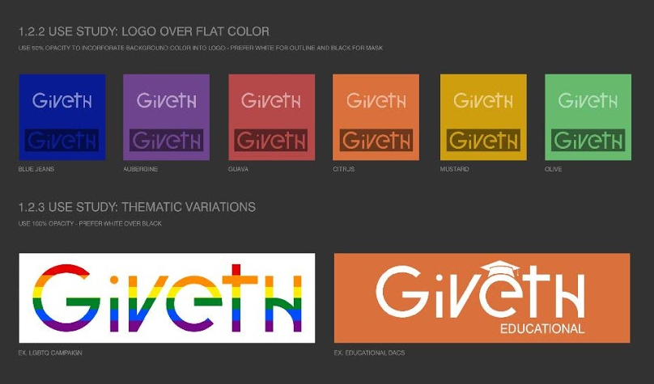

Slide 9
Giveth Logo System
By Alan Borger
click.blue

Slide 10
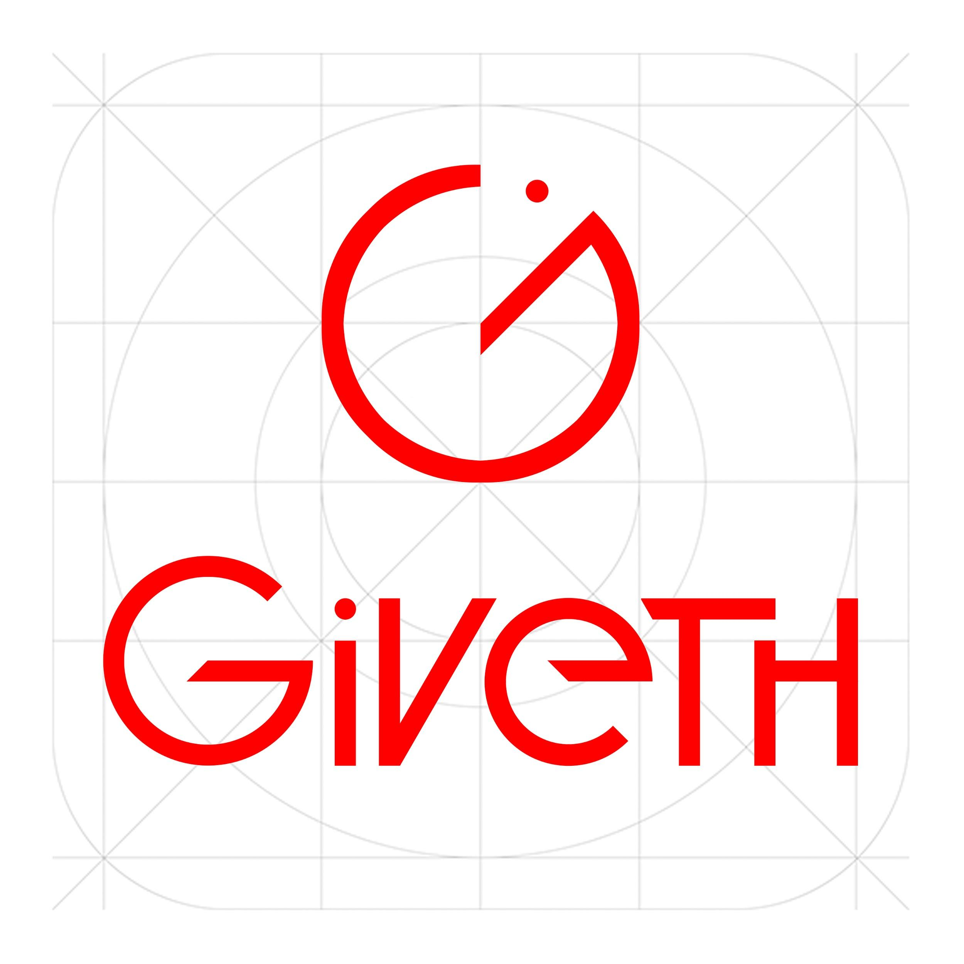
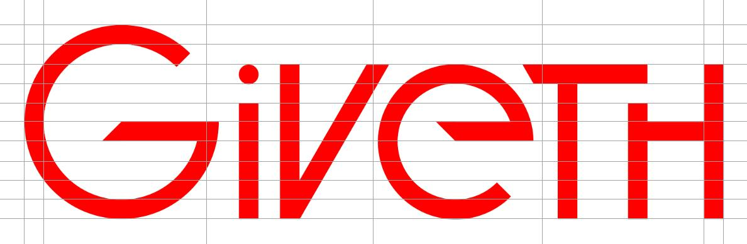
LOGO DESIGN

Slide 11
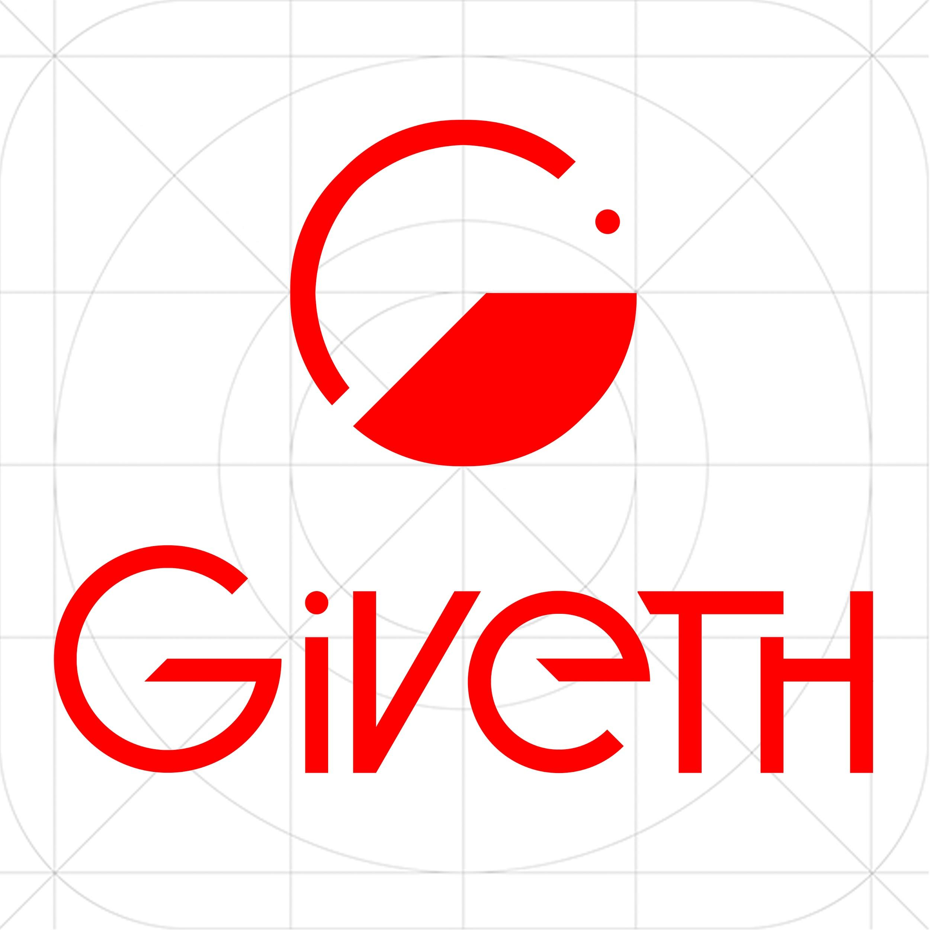

Slide 12
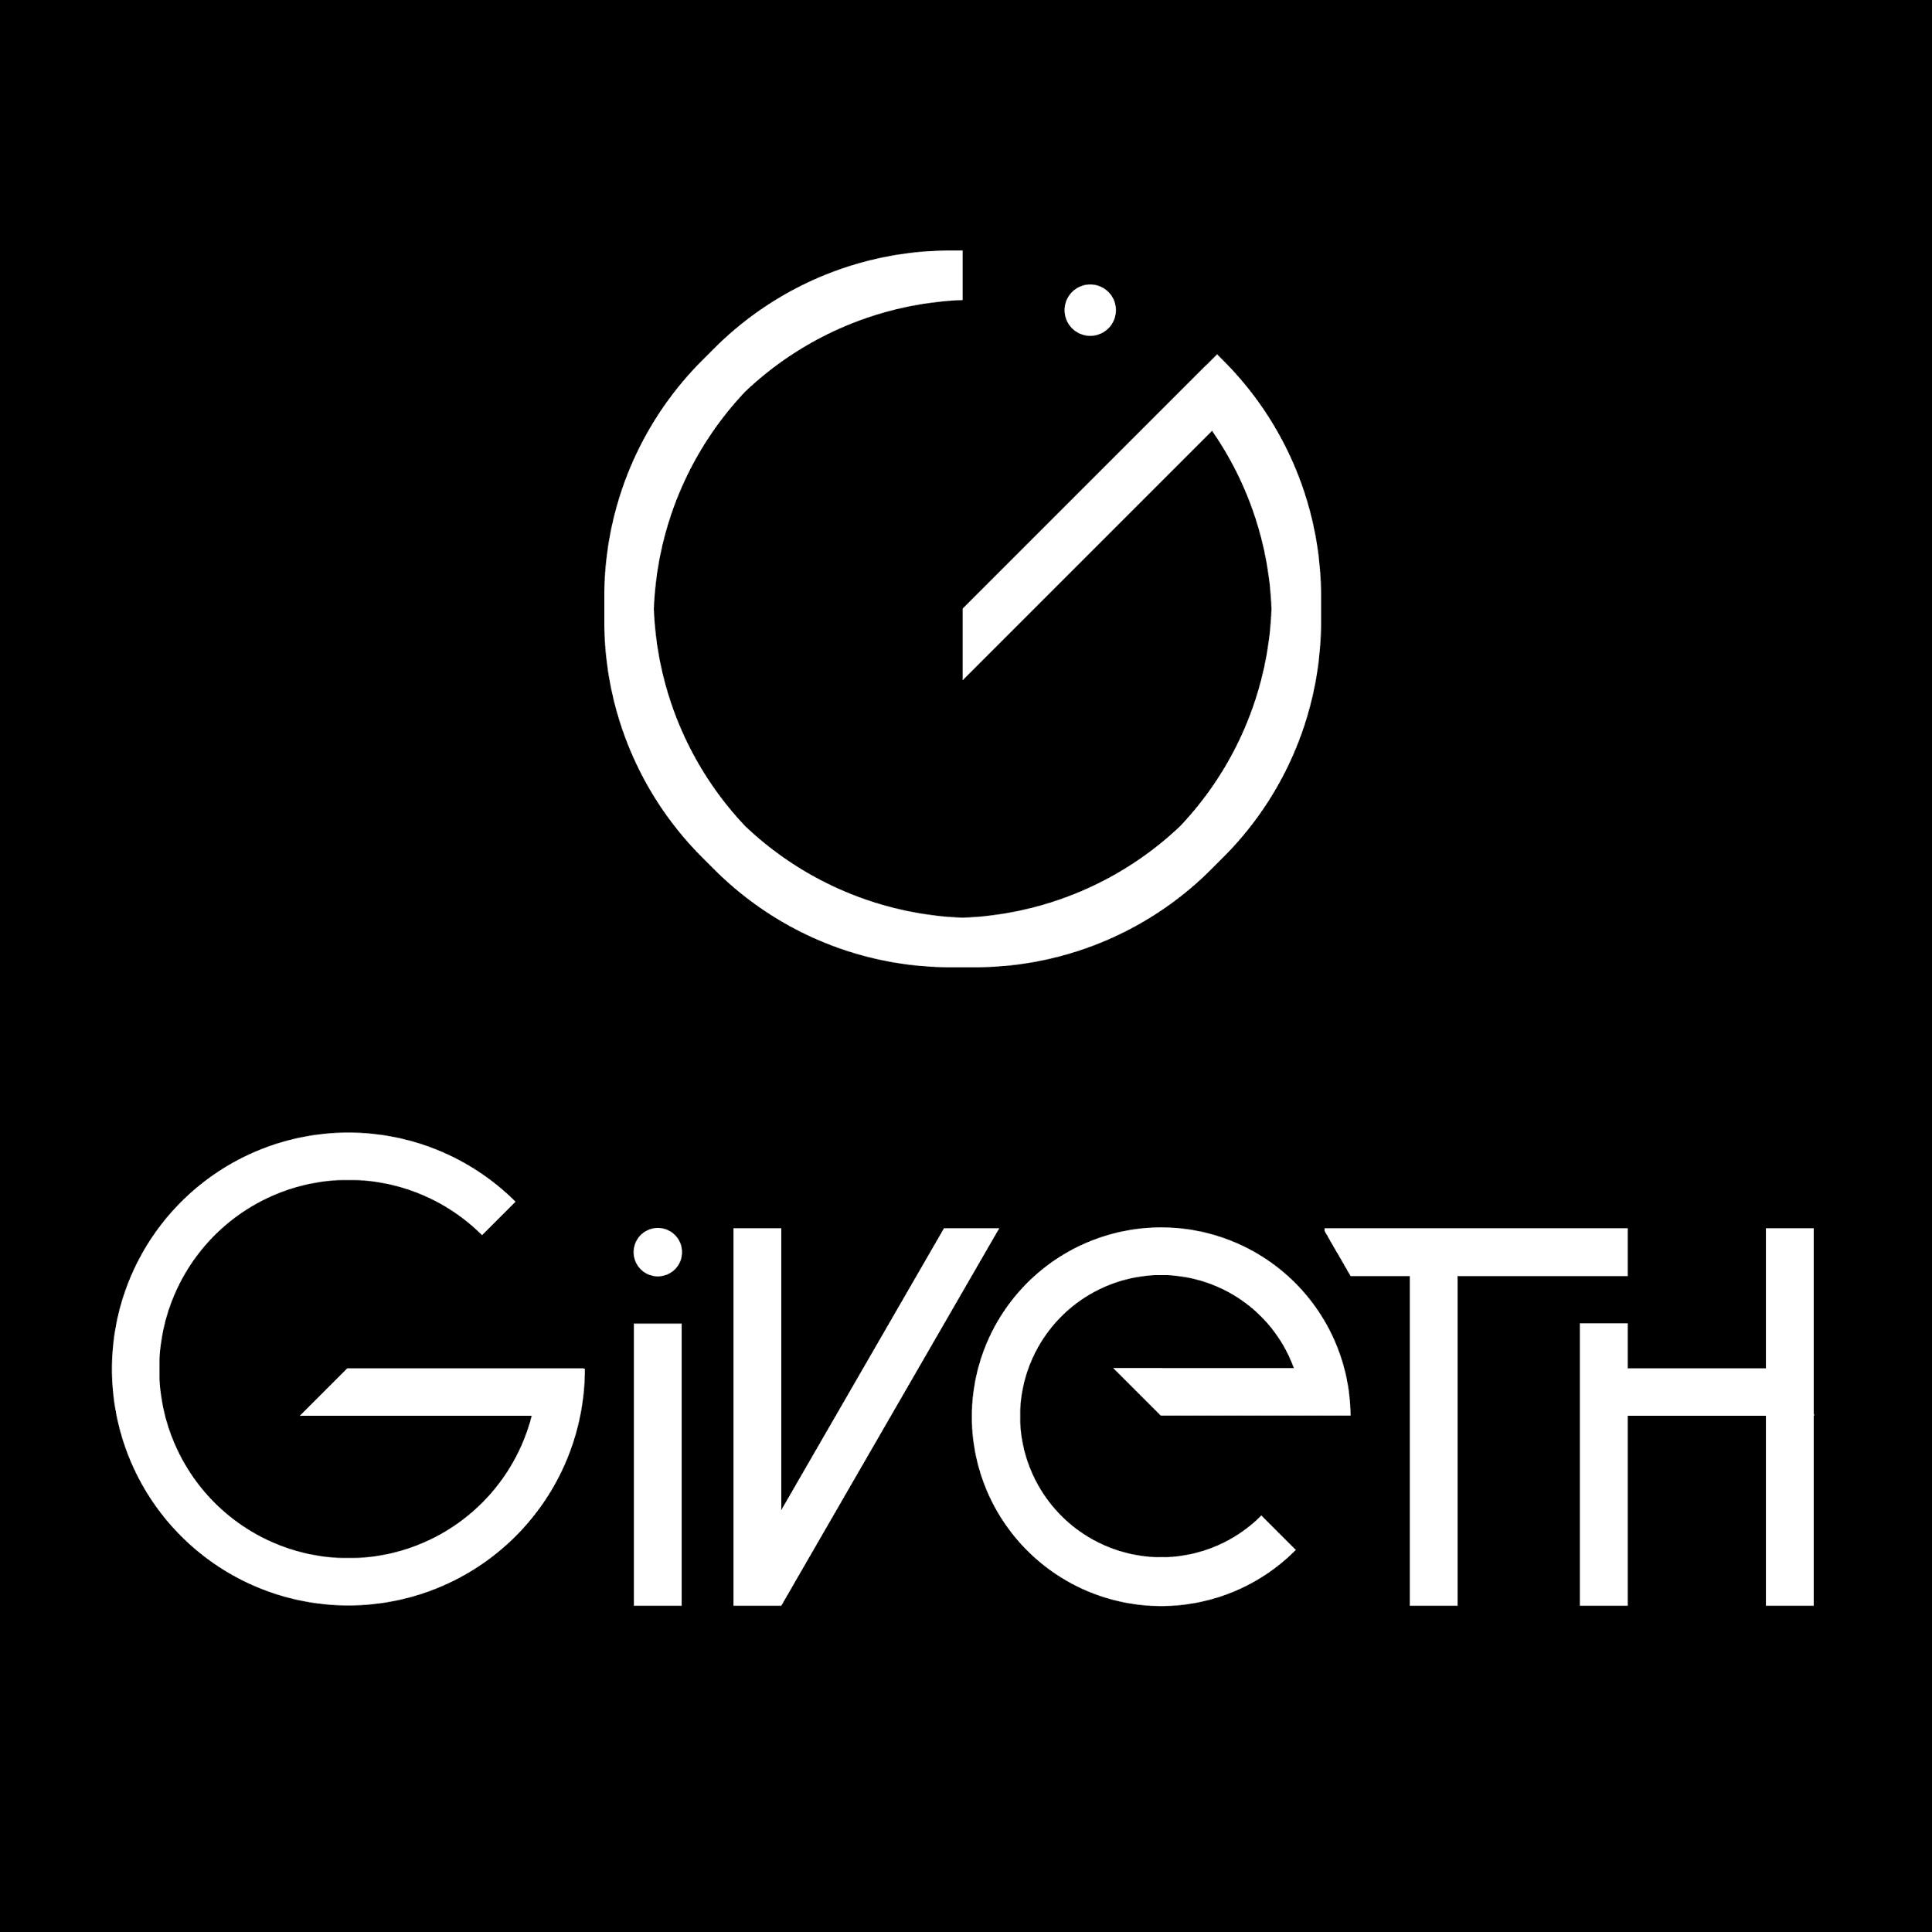

Slide 13
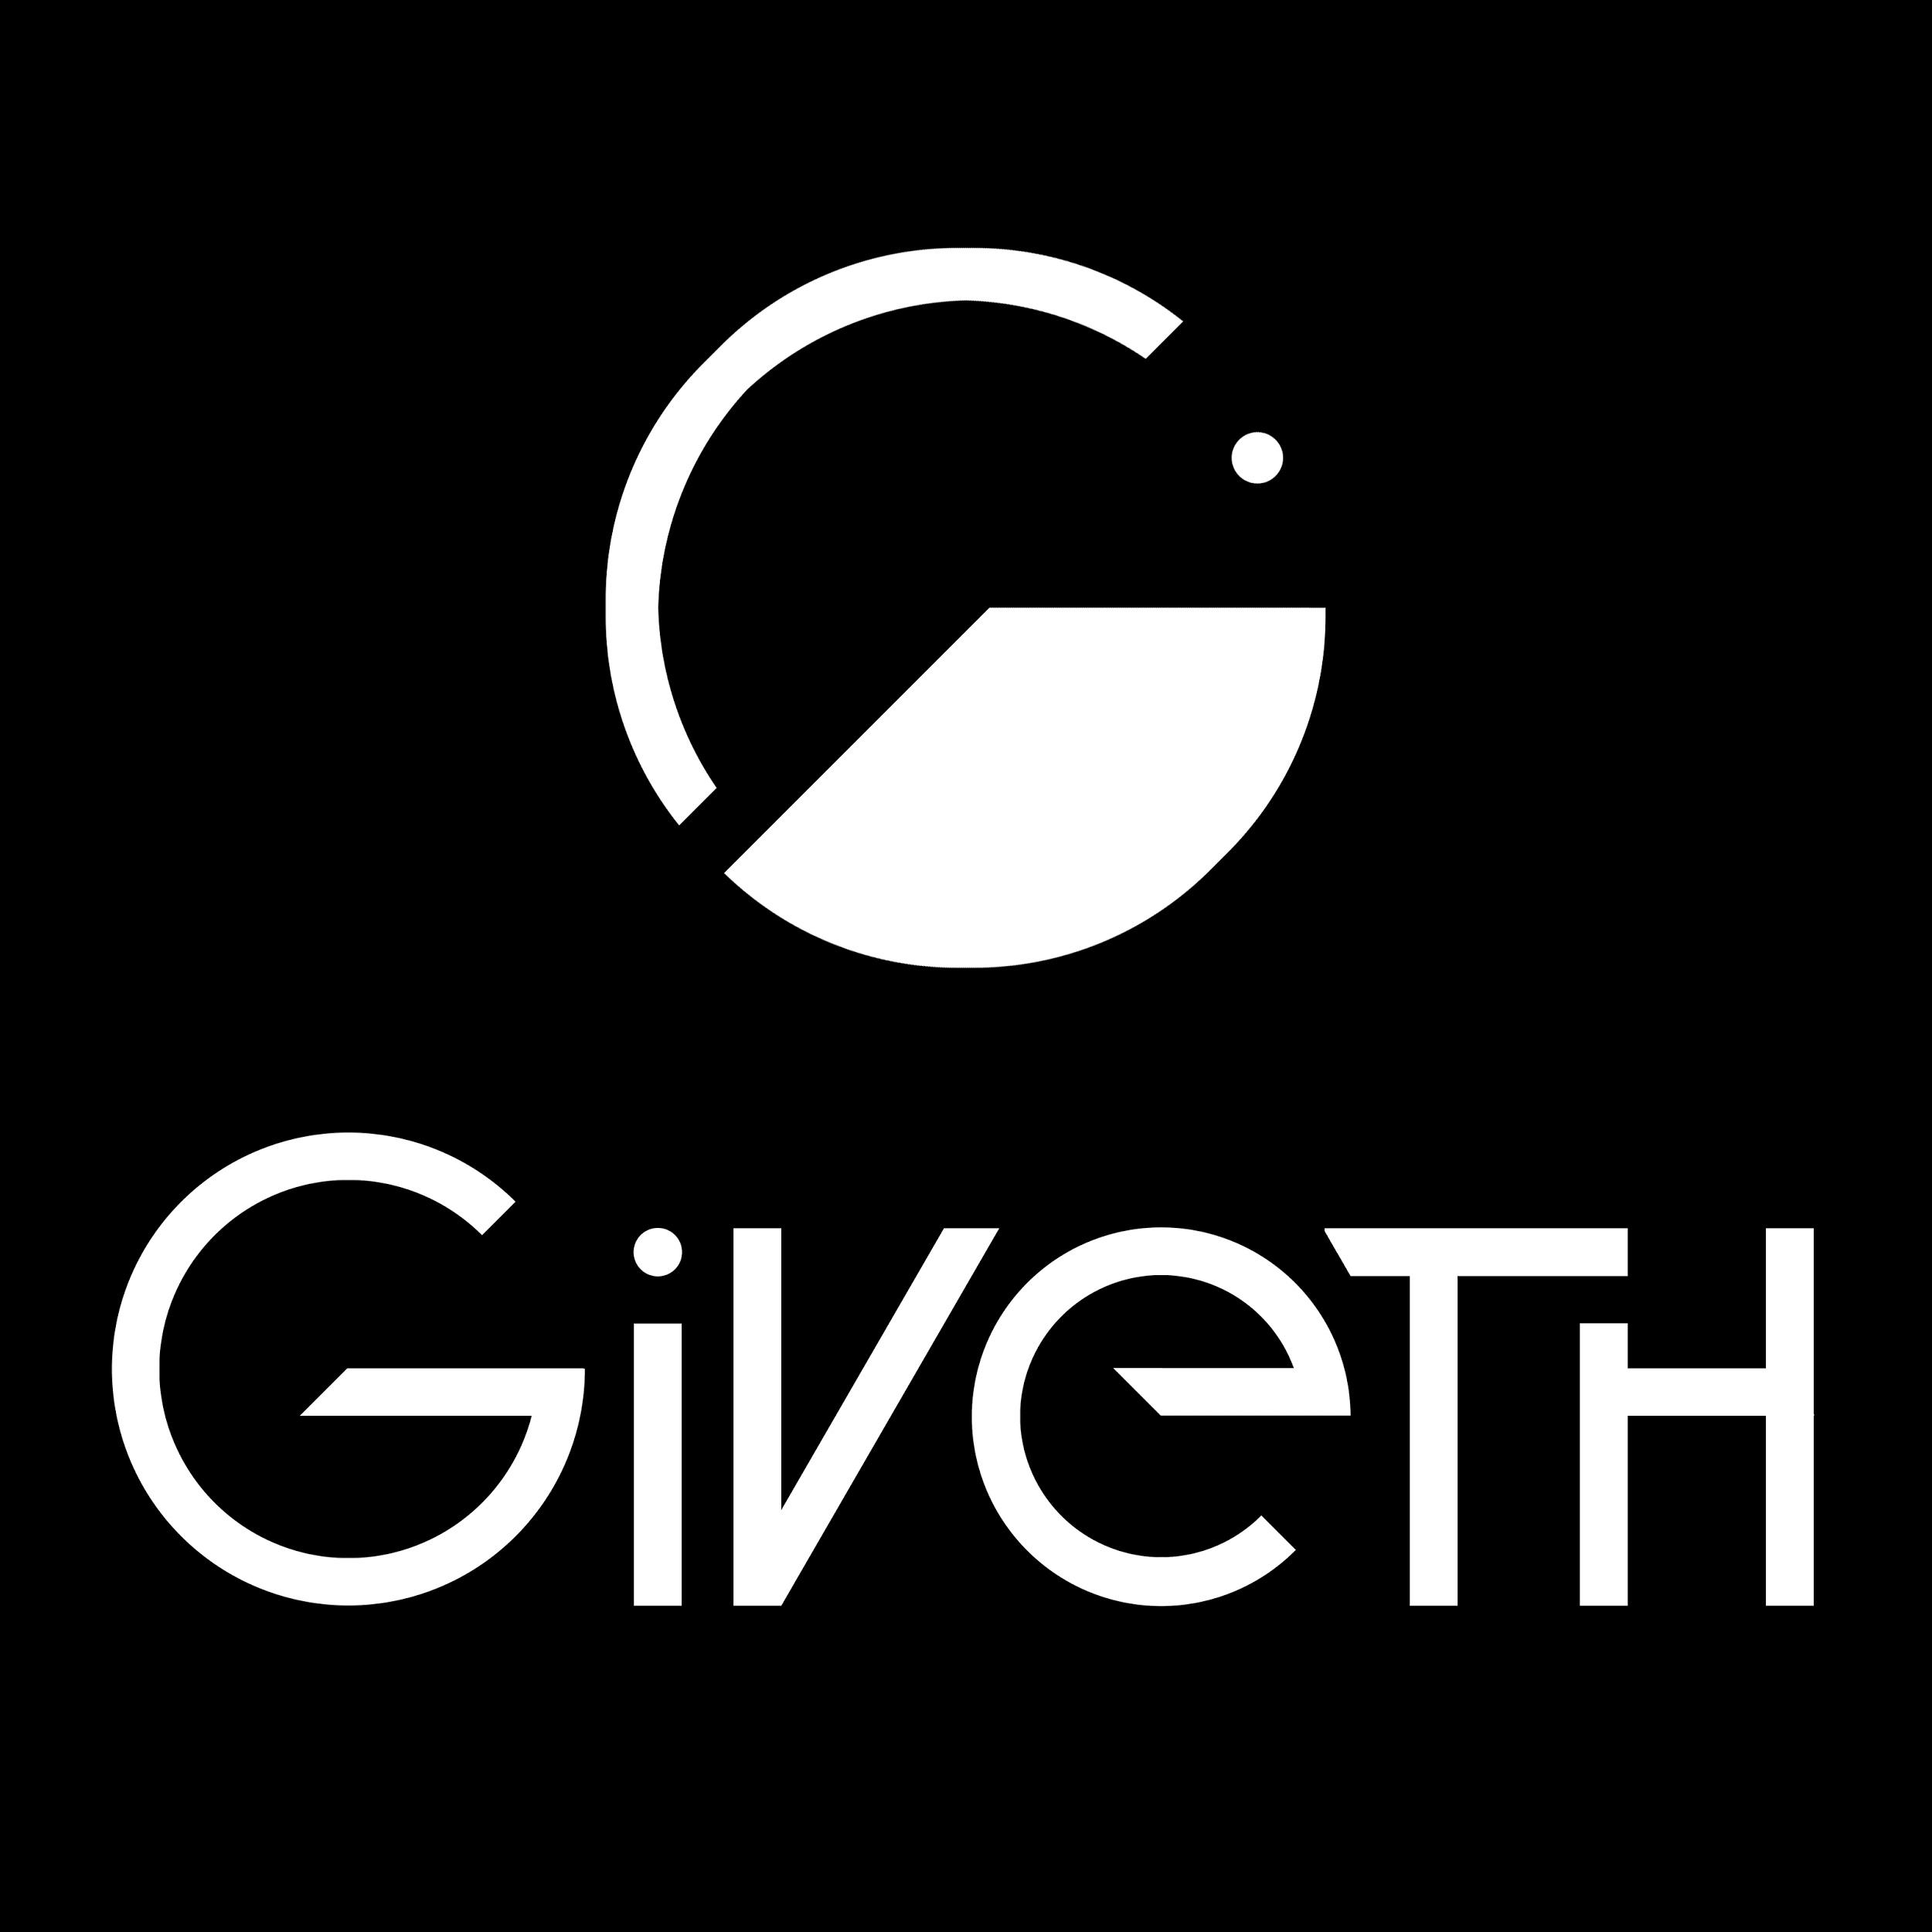

Slide 14
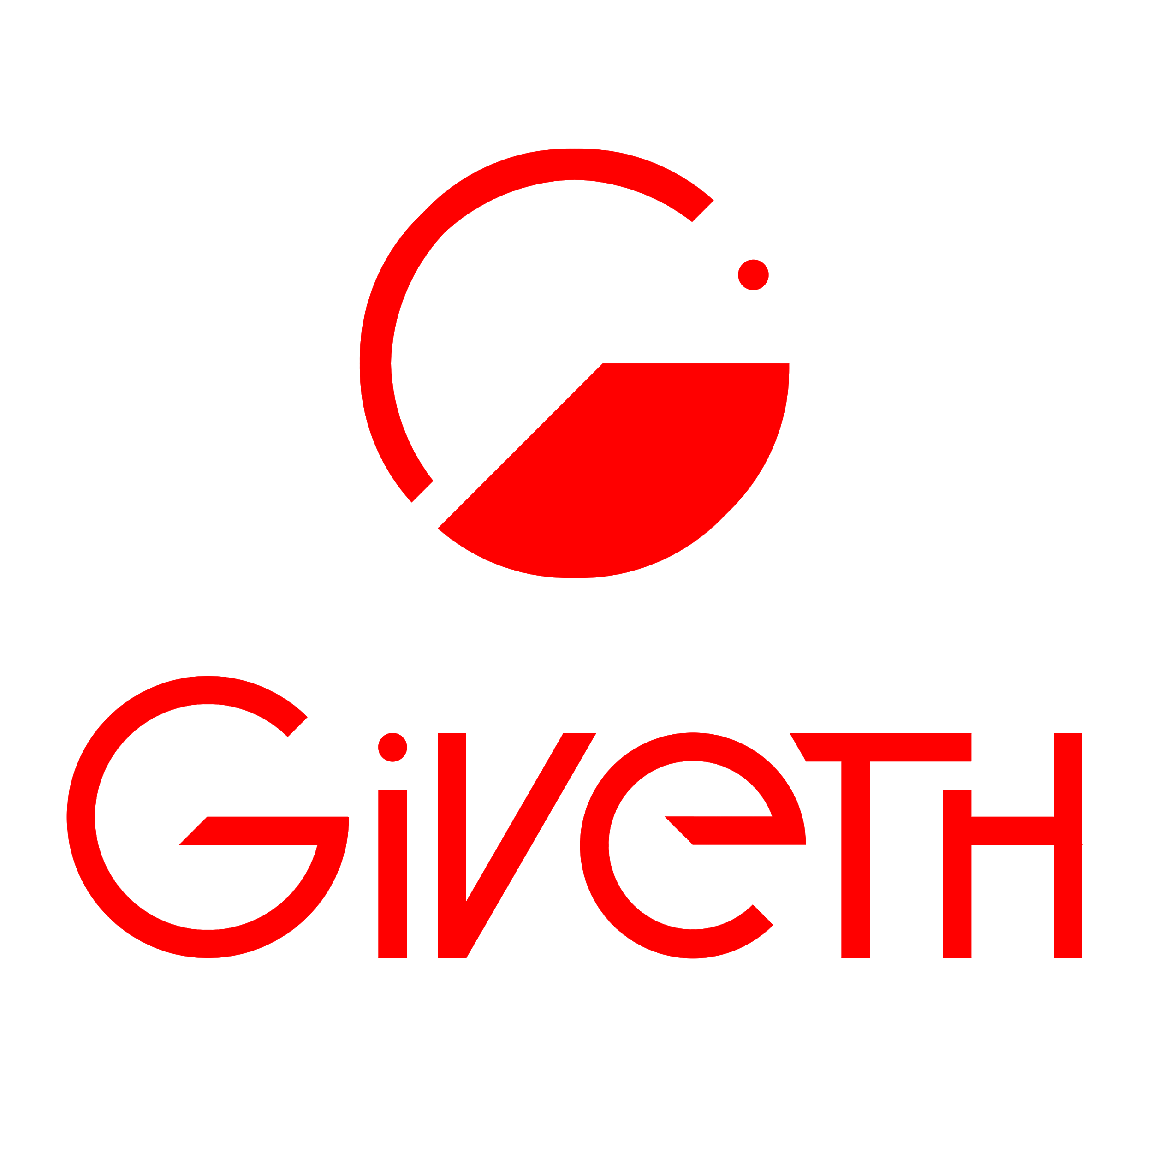

Slide 15


Slide 16



Slide 17


Slide 18



Slide 19
Final Logo

Slide 20
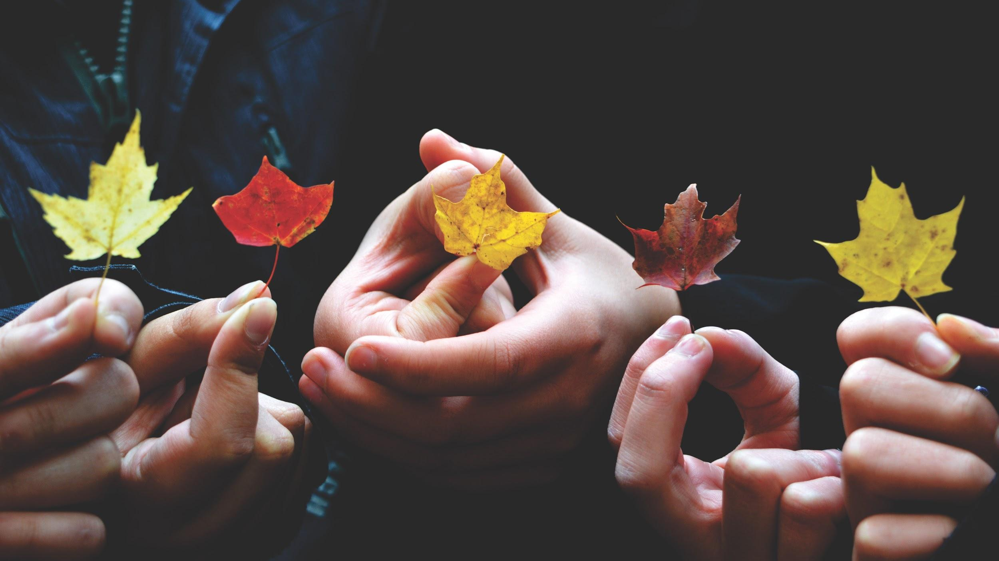


Slide 21


Slide 22


THE CLEAN WATER DAC

Slide 23
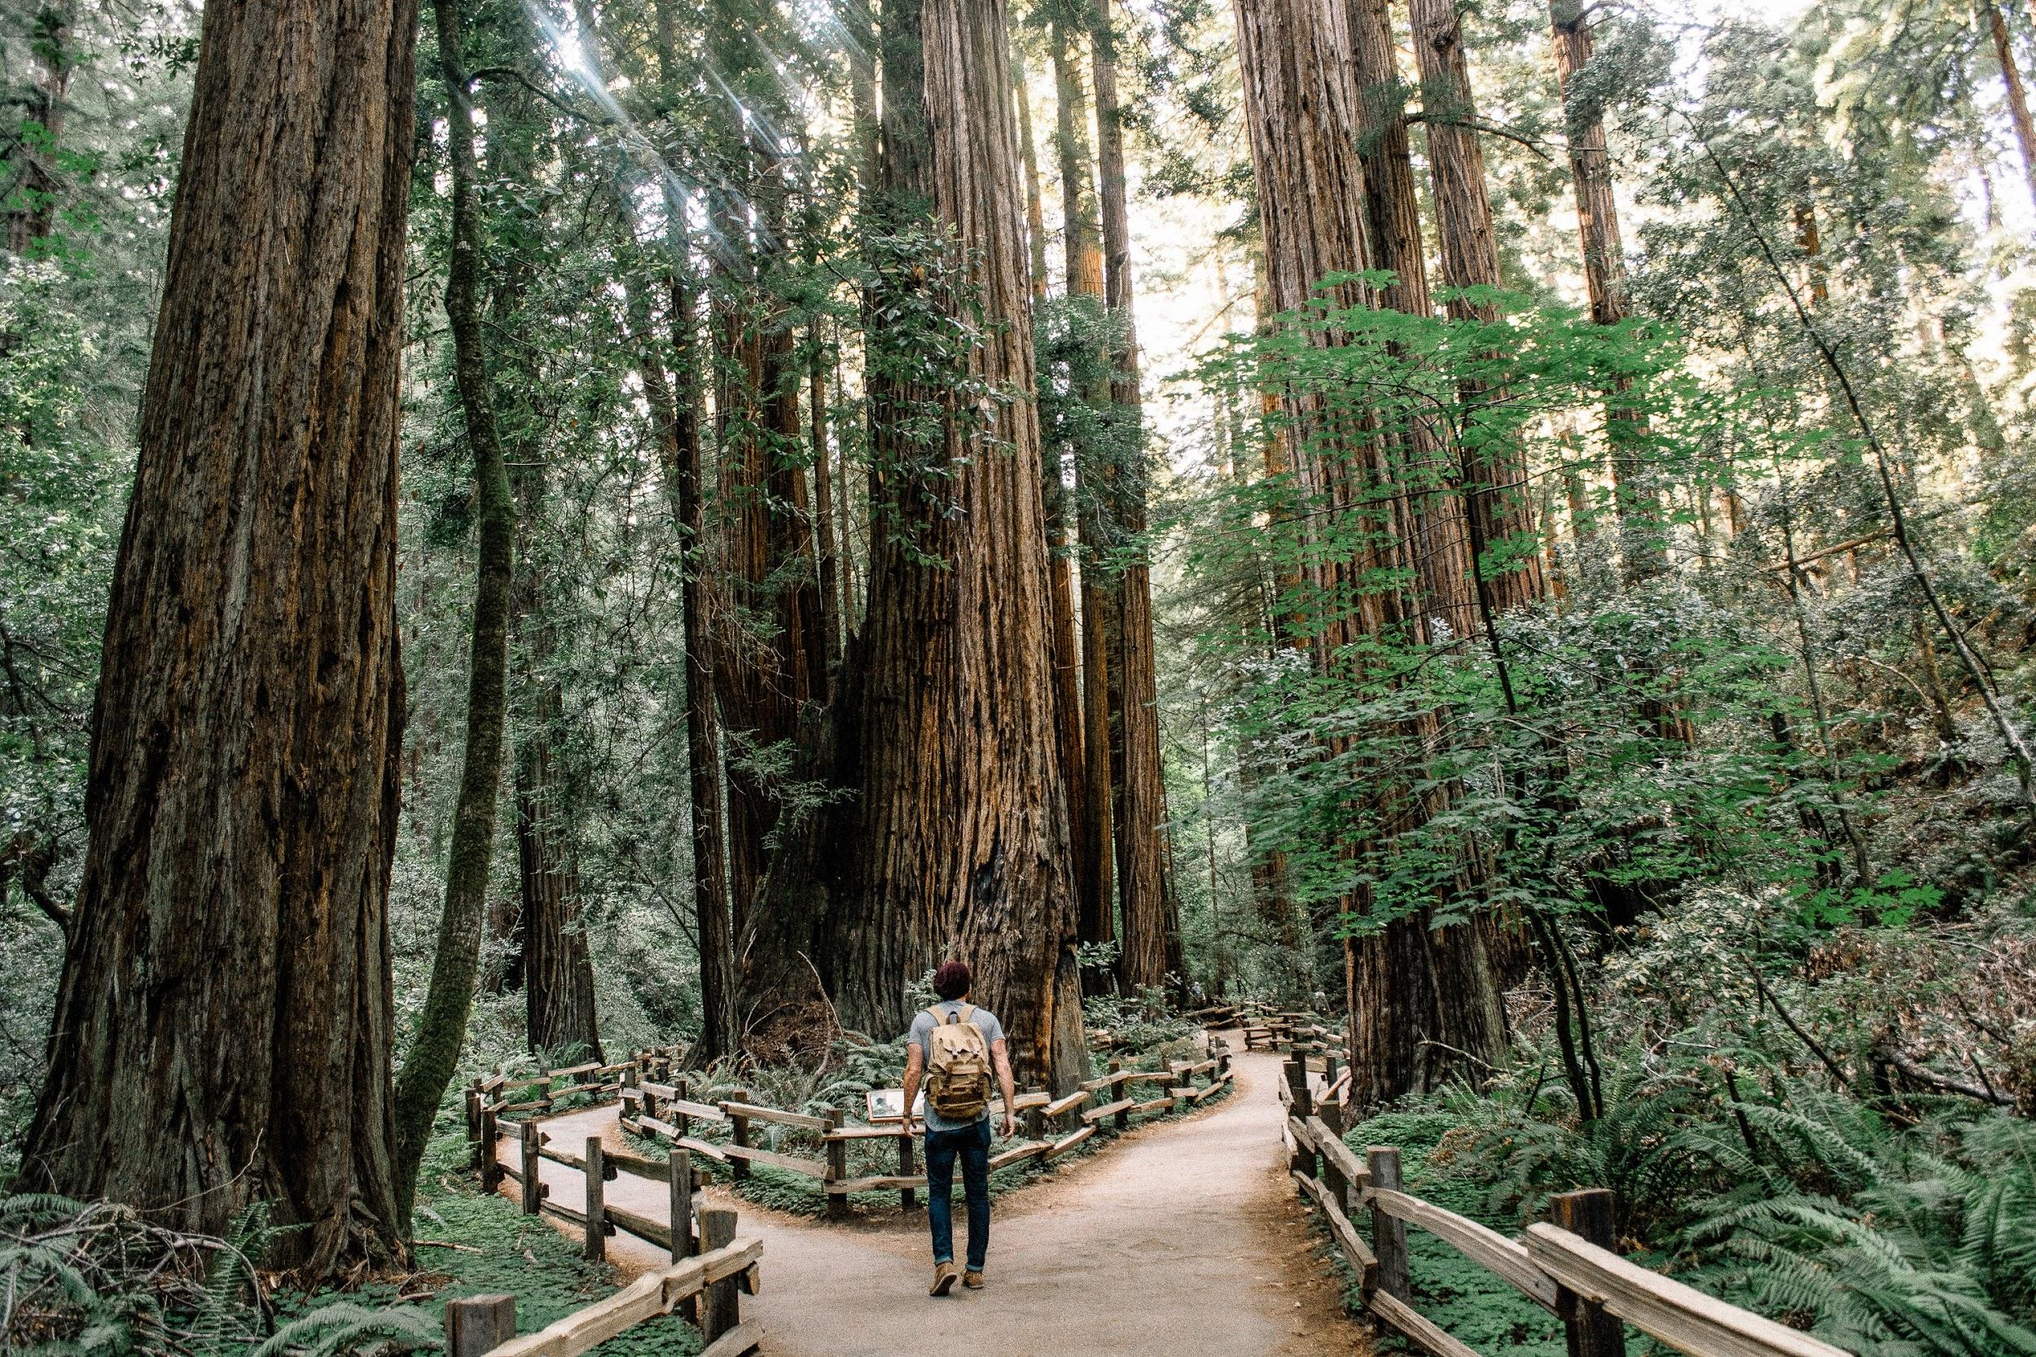
THE GREEN FOREST DAC

Slide 24
Color Options for Giveth UI

Slide 25
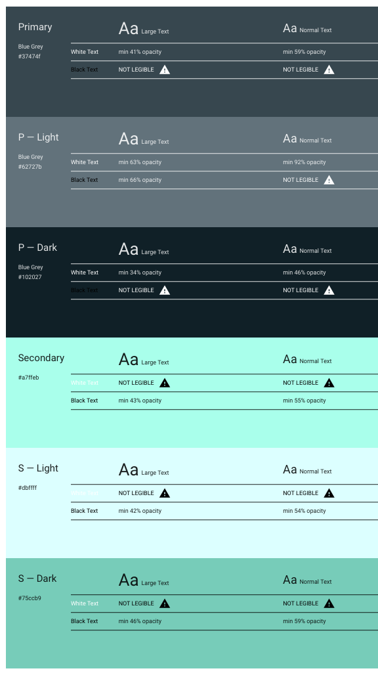

Slide 26
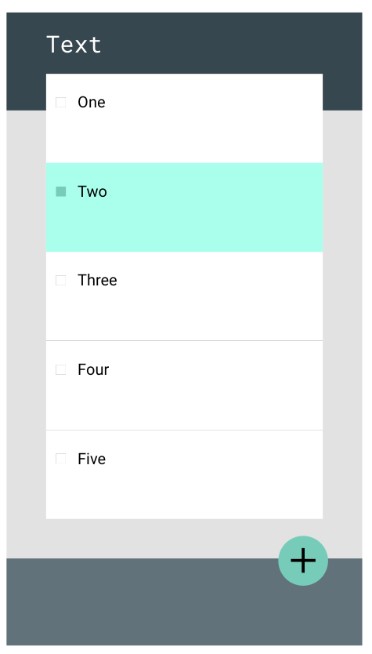
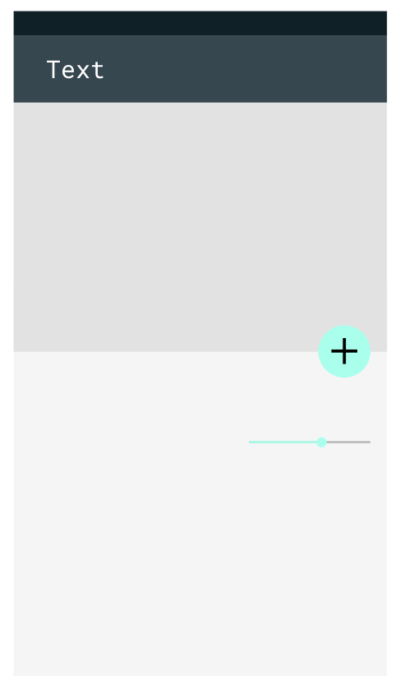
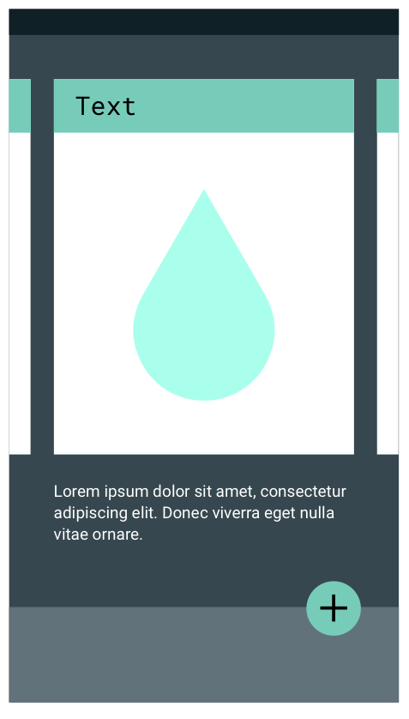

Slide 27

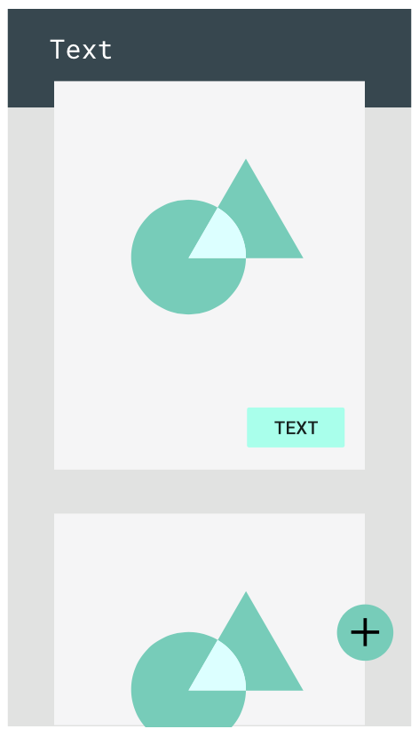
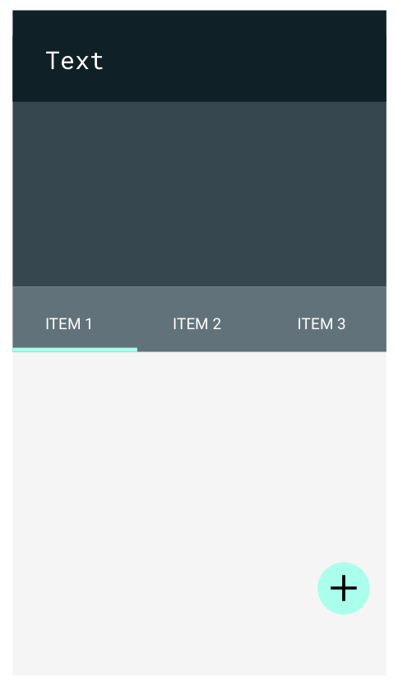

Slide 28
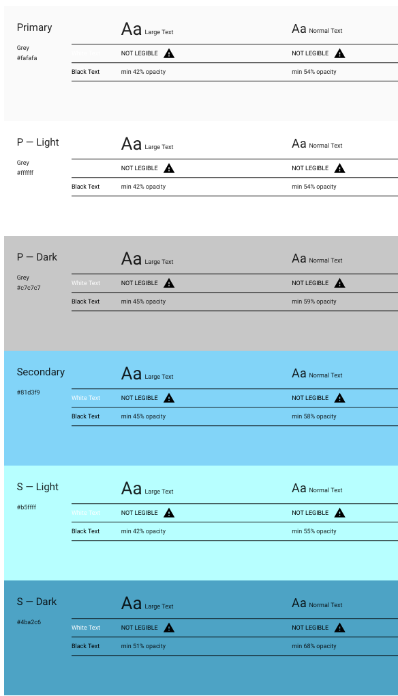

Slide 29
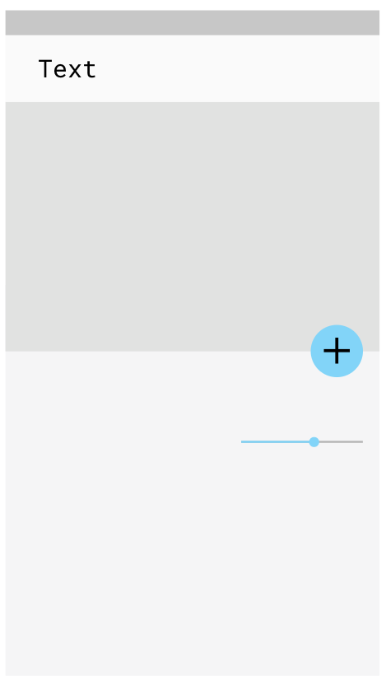
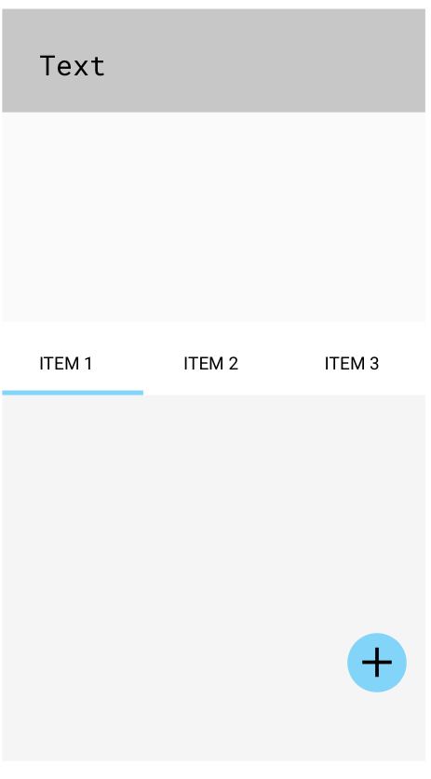
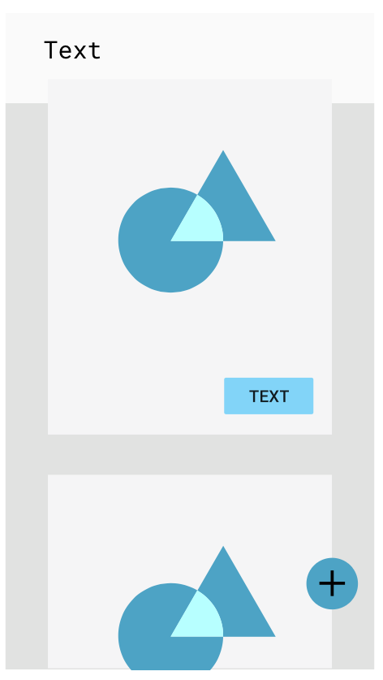

Slide 30

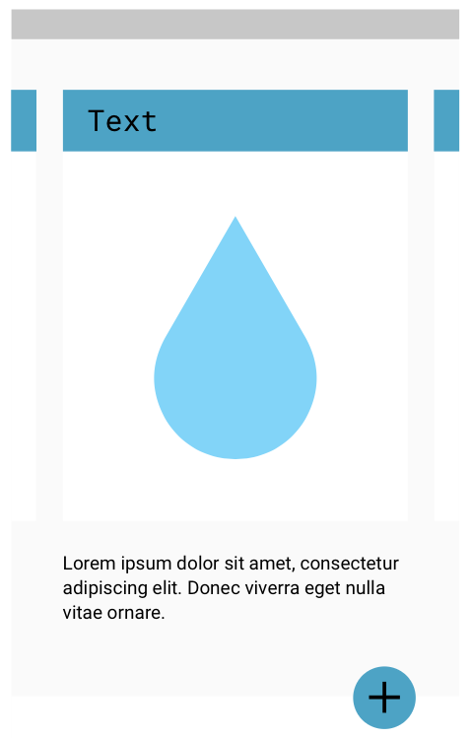
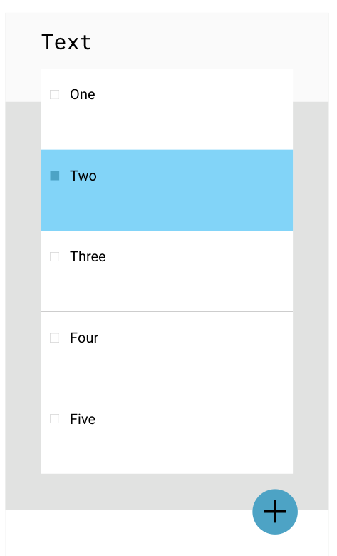

Slide 31
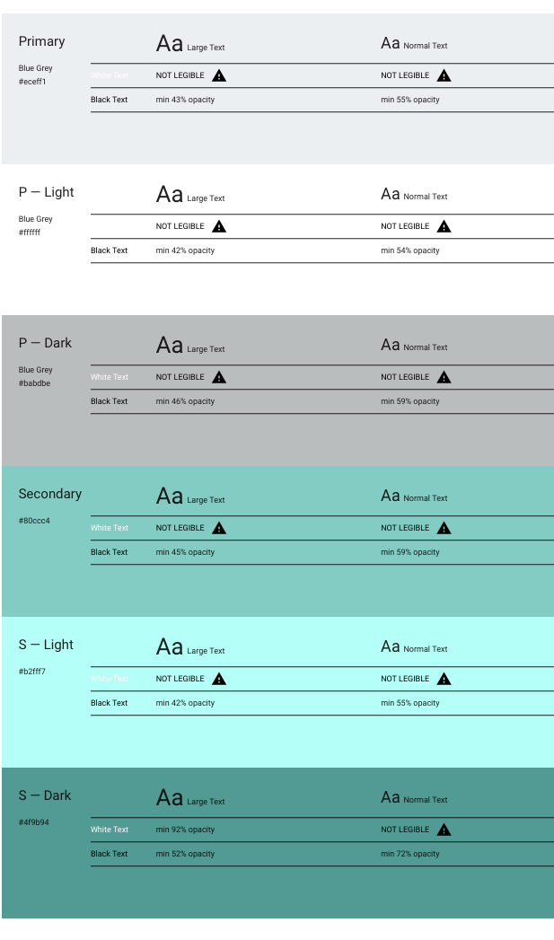

Slide 32
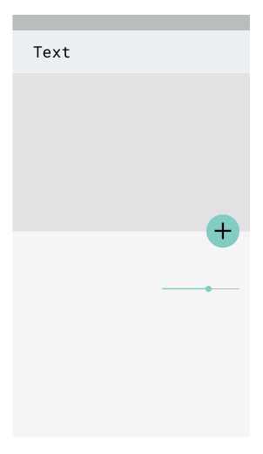
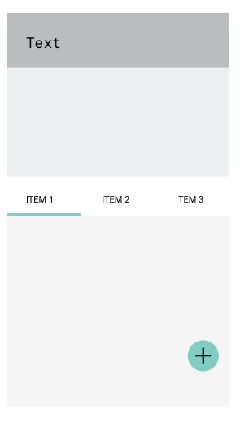
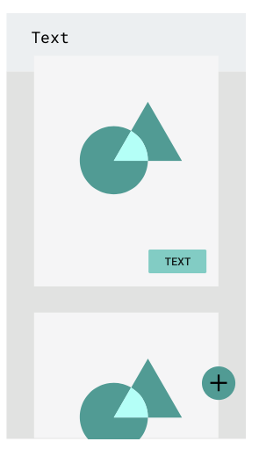

Slide 33

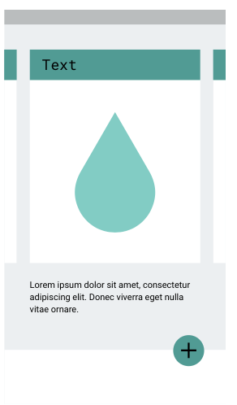
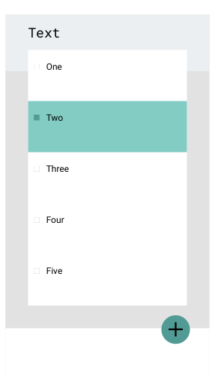

Slide 34
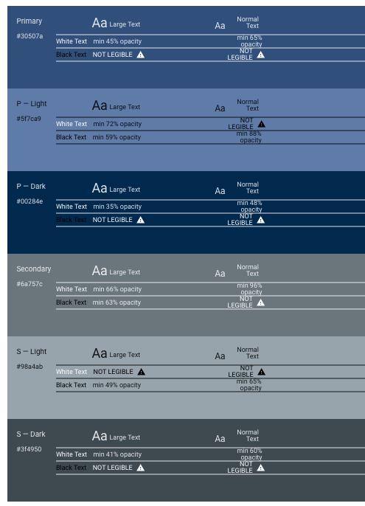

Slide 35
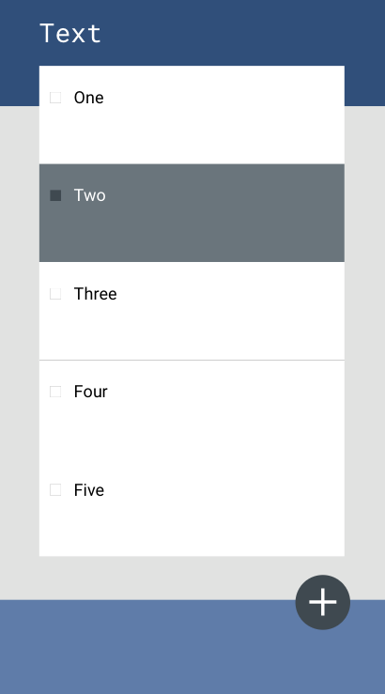
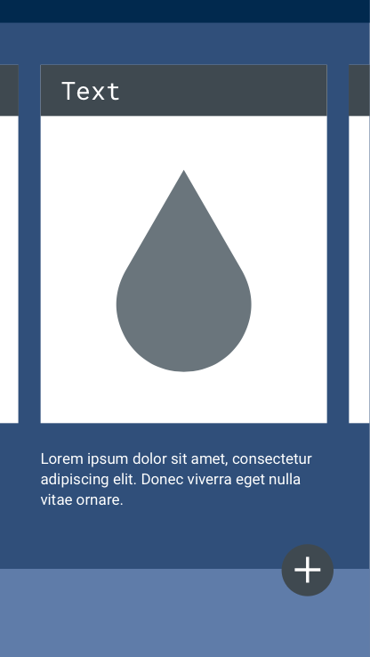
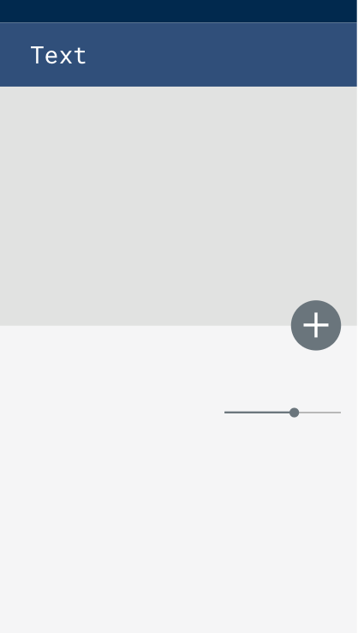

Slide 36

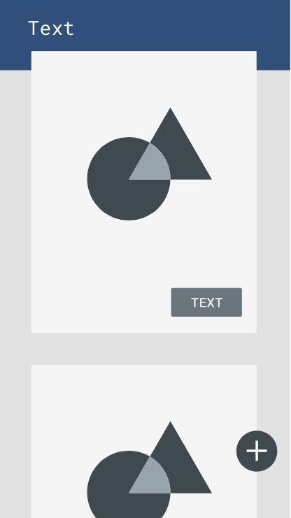
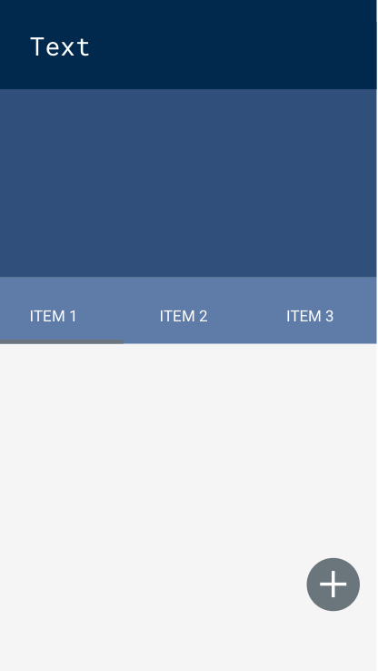

Slide 37
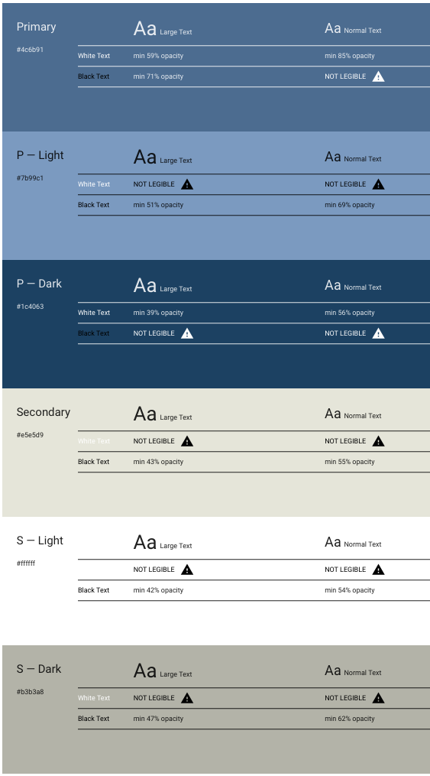

Slide 38
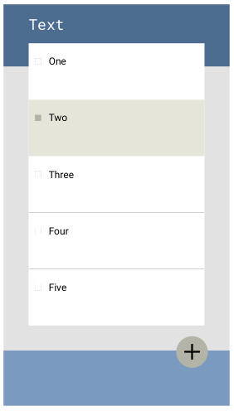
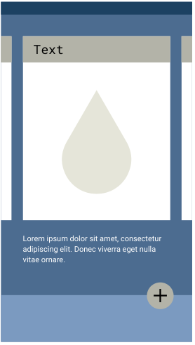


Slide 39
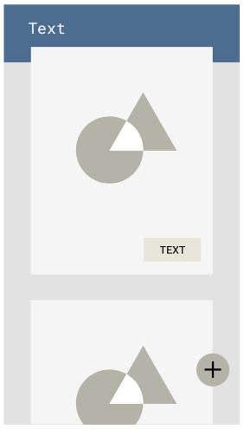
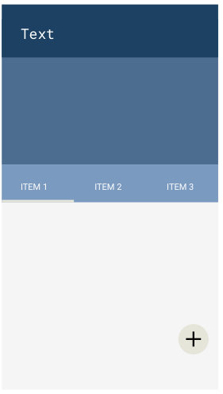
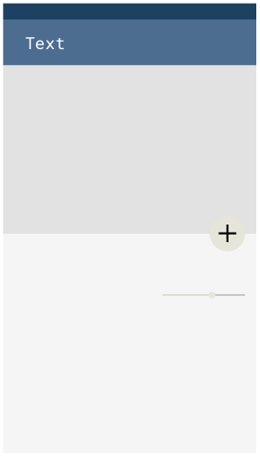

Slide 40
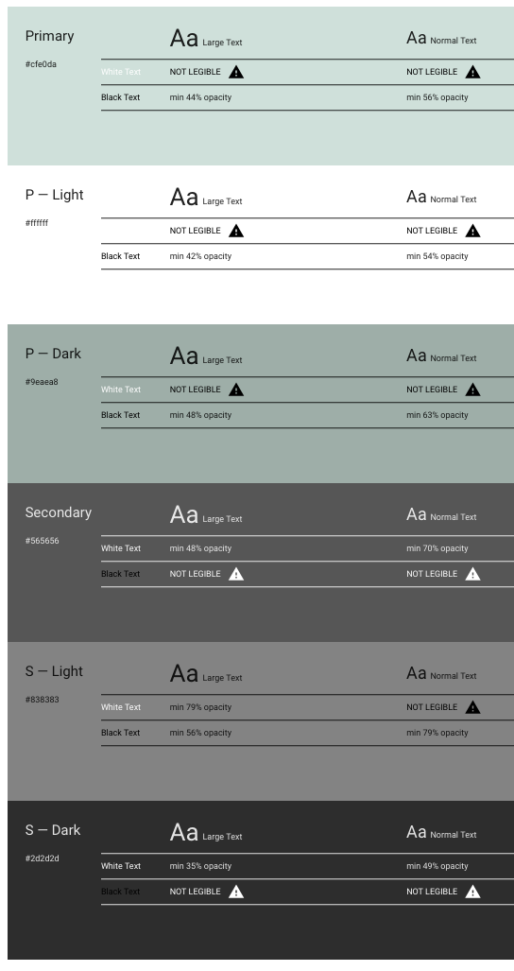

Slide 41
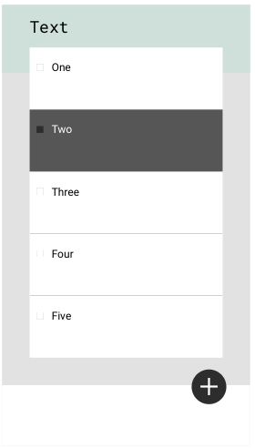
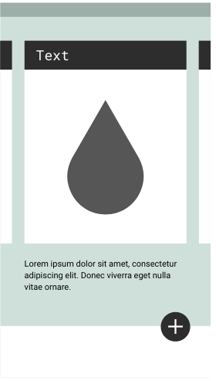


Slide 42
